Slide 1
Diffraction

Slide 2
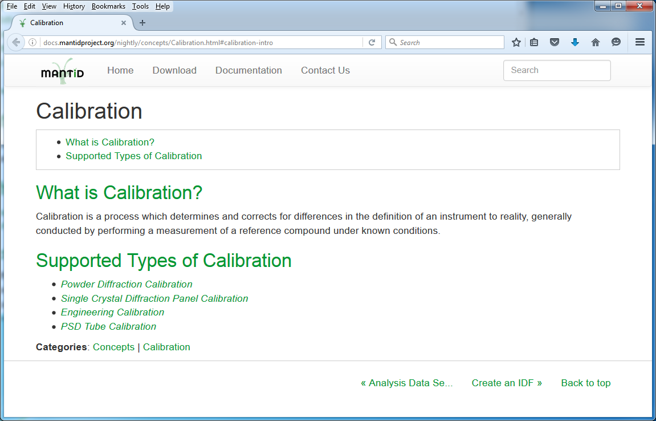
Documentation
Summary of all calibration approaches (Concepts -> Calibration):

Slide 3
Powder Diffraction
PDToGUDRUN:
Workflow algorithm that creates files suitable as input into GUDRUN
PDFFourierTransform:
Calculation of errors has been corrected
Powder diffraction scripts:
Pearl powder diffraction: scripts/PearlPowderISIS
PowderISIS renamed to CryPowderISIS: scripts/CryPowderISIS
New Pearl Powder Diffraction script documentation: API > Python > Pearl Powder Diffraction Script
PowderISIS documentation renamed to Crystallography Powder Diffraction Script: API > Python

Slide 4
Single Crystal
SCDCalibratePanels:
3 new output ws (calculated vs theoretical characteristics of each peak), option for Simplex minimization, many more…
LoadCIF:
can now also load structures where only anisotropic displacement parameters are given
SaveHKL/LoadHKL:
Option to write/load direction cosines
SaveIsawPeaks
Has DetCal information stored by detector numbers
StatisticsOfPeaksWorkspace
Has resolution shells in units of d-Spacing
SpaceGroup: now has a method to check whether a specified unit cell is compatible with the symmetry operations of the group.

Slide 5
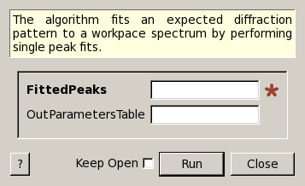
Engineering Diffraction
GSASIIRefineFitPeaks:
Uses GSAS-II to refine lattice parameters and/or fit peaks
EnggFitPeaks :
Modified to fit peaks but not calibration parameters
EnggFitDIFCFromPeaks:
Finds calibration parameters DIFC, TZERO from list of peaks fitted to a diffraction pattern
SaveNexusPD:
Save powder diffraction data to a Nxentry of a NeXus file
EnggCalibrateFull:
New option to set the initial rebin width
EnggFocus:
Option to mask out several ranges in ToF
Phase information files for ENGIN-X (in addition to ENGIN-X scripts)

Slide 6
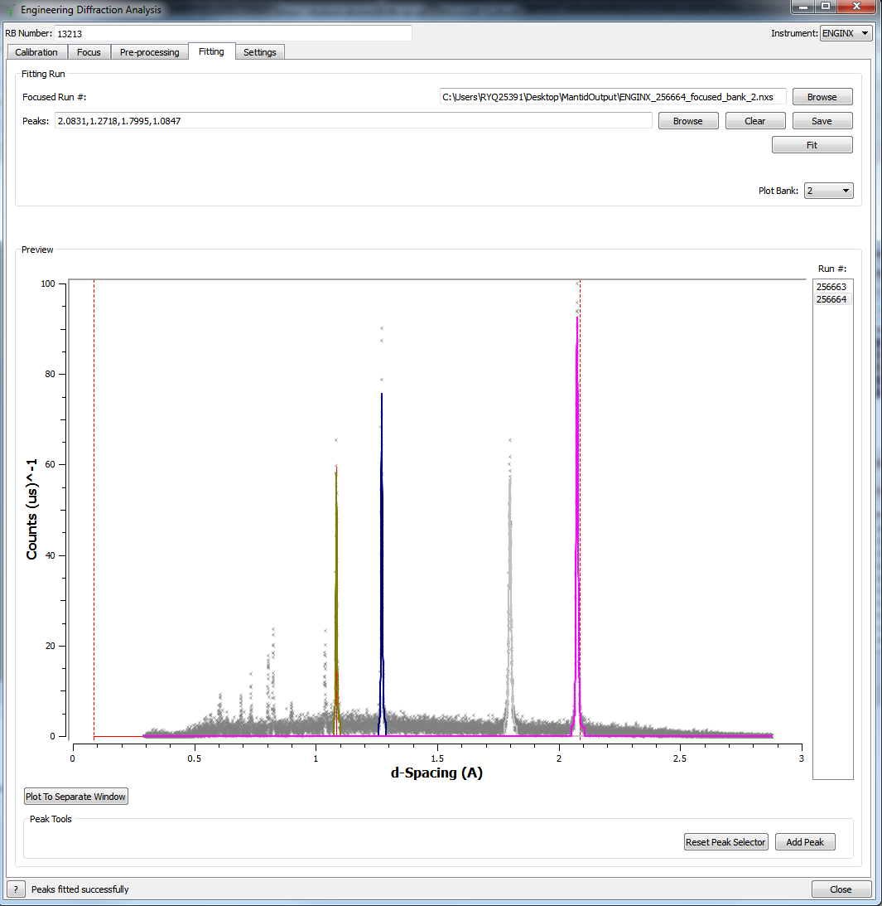
Engineering Diffraction
Calibration:
Custom bank name will be used to set the ws name
Output calibration files written to .prm by default.
Together with an “all-banks” calibration file, an individual file for every focused bank will be written
Fitting tab:
Preview: zomm-in, zoom-out, add, select and save peak, plot in d-Spacing instead of ToF, etc.
“Plot to Separate Window” button to plot single peak in separate ws
Option to clear peak list
Many more…

Slide 7
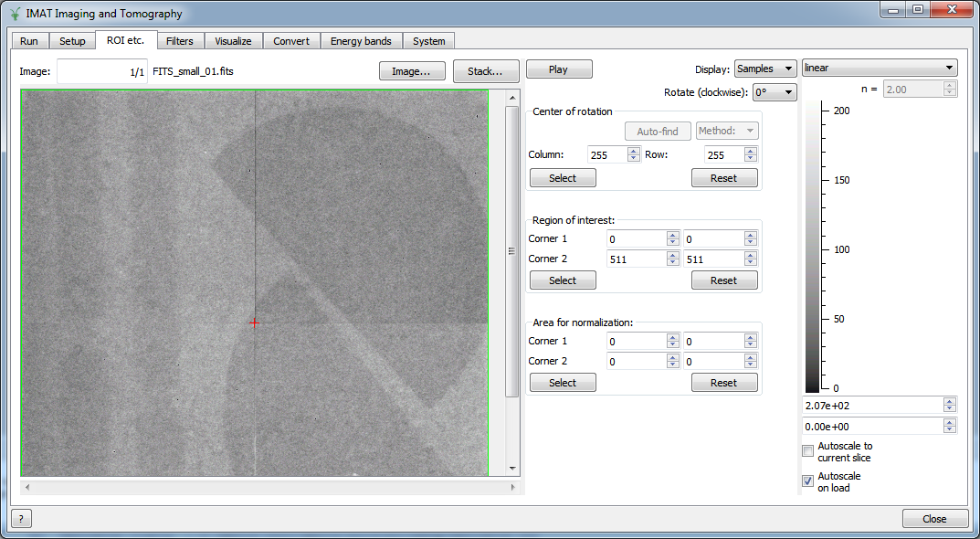
Imaging
ImggAggregateWavelengths: Aggregate stacks of images from multiple energy bands or wavelengths
ImggTomographicReconstruction: First version that implements the Filtered Back-Projection (FBP) reconstruction method using the FBP implementation of the TomoPy package
SaveFITS: Images loaded as Mantid workspaces can be saved into FITS files
GUI:
Handle rotation of all images
Play the sequence of images
Visualize sample, flat and dark images separately
Color bar options
And many more…

